Slide 1

By Team AURIEL. Akshaya Venkatesh, David Kelly, Pallavi Arivukkarasu, Yinan Guo

Slide 2
Mission
Auriel, simply put, aims to serve as an eye to a visually impaired person. It is a simple and user-friendly app that combines the use of voice input, gestures and minimal UI to achieve safe, quick and comfortable indoor navigation within buildings.

Slide 3
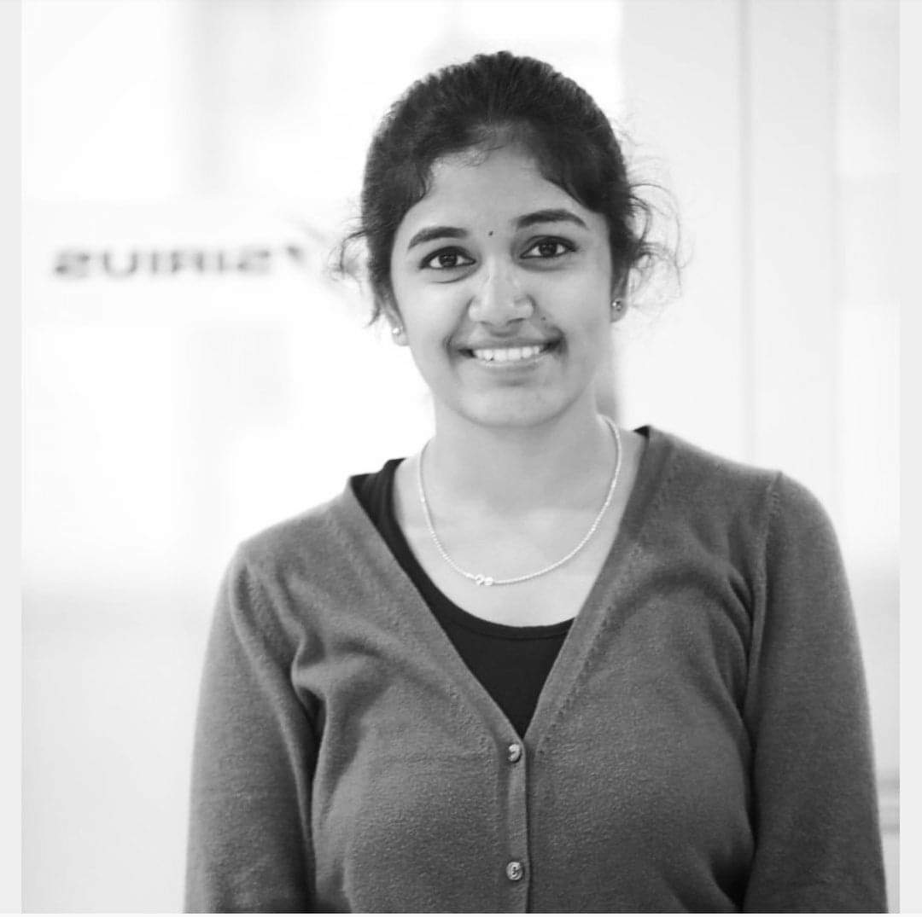
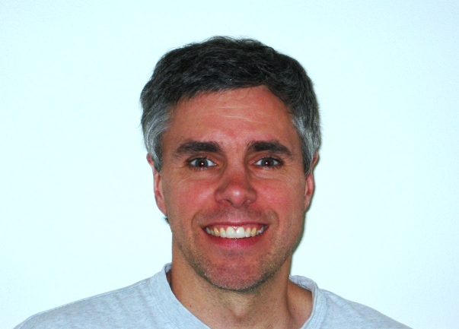
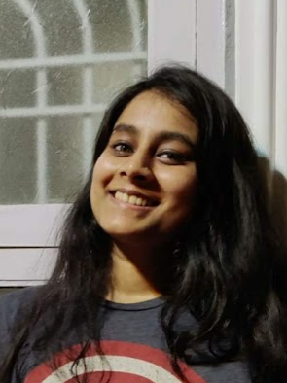

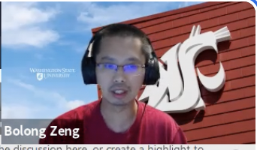
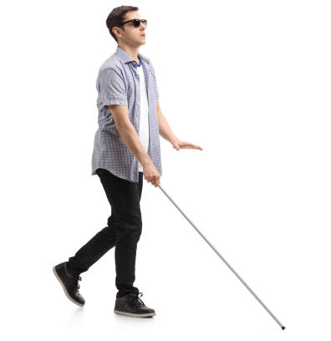
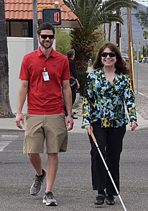
Stakeholders
Blind / Visually impaired people
Assistive person / Caretaker
Dr. Bolong Zeng
Developers/Engineers:
Akshaya Venkatesh
David Kelly Edward
Pallavi Arivukkarasu
Yinan Guo
Testers:
Subset of Students from WSU Pullman

Slide 4
Timeline
Aug 23, 2021
Requirement Engineering
The project preliminary plan was created. The app’s preliminary definition was thoroughly analysed and the WRS document was prepared
October 15, 2021
Design
The app’s mock up screens are ready. Based on the mockup’s and requirement definitions the app designs will be created.
TBD
Implementation
The design files shall be used in combination with the requirement specifications to develop the application.
TBD
Testing and Launch
The app will be shared discretely with random WSU student
Notes:
Design - starting tomorrow. The impl will start in couple weeks, test and launch before dec.

Slide 5
AS-IS, TO-BE Scenario 1
AS-IS
TO-BE
Jodi is trying to go to class number 101, but gets to know the class has been moved to 109.
She knows the route to 101 by default but is facing difficulty to find 109.
She asks for help but people are busy moving around to get to their own classes.
Jodi is trying to go to class number 101, but gets to know the class has been moved to 109.
She knows the route to 101 by default but is facing difficulty to find 109. This case will work even if the wifi.
She gives the new location to Auriel, and she gets the directions to the classroom instantly.

Slide 6
AS-IS, TO-BE Scenario 2
AS-IS
TO-BE
Jodi is going to the lecture hall situated in the first floor.
However, she accidentally trips and falls down.
She tries to signal for help but nobody is around to help her.
The Auriel app asks Jodi to give her current location and the destination.
The app calculates the route from the current location to the destination.
She accidentally trips and falls down.
She immediately presses a button linked to the Auriel app and an assistant is there to help her within few minutes.

Slide 7
AS-IS, TO-BE Scenario 3
AS-IS
TO-BE
Jodi needs help navigating, and her friend Kanu who is also her helper is with her.
Jodi asks Kanu for directions but Kanu is also not sure what way to go.
They take a long time to figure out the direction to the class.
Once Jodi asks Kanu for help. Kanu pulls out Auriel app and locates the room Jodi is looking for.
The app calculates the route from the current location to the destination.
Kanu is now able to guide Jodi with the instructions from Auriel

Slide 8
AS-IS TO-BE Analysis of Scenario 3
What if the user wants to change the destination? Use gestures on phone or use voice commands.
What happens in a risky scenario? In case the Wifi does not work or the battery is low.
What if the user just needs the assistant?

Slide 9
Function points
Inputs - 25 | Device location, Contact info for caretaker, Voice commands Gestures Button click
Outputs - 10 | Voice directions, alerts, vibrations, transcripts(screen-output)
Internal Logical File - 50 | Logic that determines path between location A and B
External Interface File - 40 | Building Model - building floor plans, beacon locations, id and info, building caretaker info
External Inquiries - 25 | Nearest beacon, Set of all beacons on the current path
External Input (40) | Building Model,
External Output 30 | Calls User’s path tracking data

Slide 10
Creeping rate
The requirement definition currently addresses 180 function points and we have about 2 months of time to complete the development of the app.
As the development progresses, due to better understanding, 4 function points are expected to added.
Thus the expected function creep increments at, 10 FPs each month, giving us 11.1% creeping rate for each month.

Slide 11
Comparisons for Cane, Dog, Jodi and Auriel
 | Cane | Dog | Jodi | Auriel | Jodi + Cane | Jodi + Dog | Jodi + Cane + Auriel | Jodi + Dog + Auriel
See | No | Yes | No | Yes | No | Yes | Yes | Yes
Detect Obstacles | Yes | Yes | No | Yes | Yes | Yes | Yes | Yes
Detect Fall | No | Yes | Yes | Yes | Yes | Yes | Yes | Yes
Hear | No | Yes | Yes | Yes | Yes | Yes | Yes | Yes
Can understand user | No | Yes | Yes | Yes | No | No | Yes | Yes
Can alert assistant | No | Yes | Yes | Yes | Yes | Yes | Yes | Yes
Can give directions | No | No | Yes | Yes | Yes | Yes | Yes | Yes

Slide 12
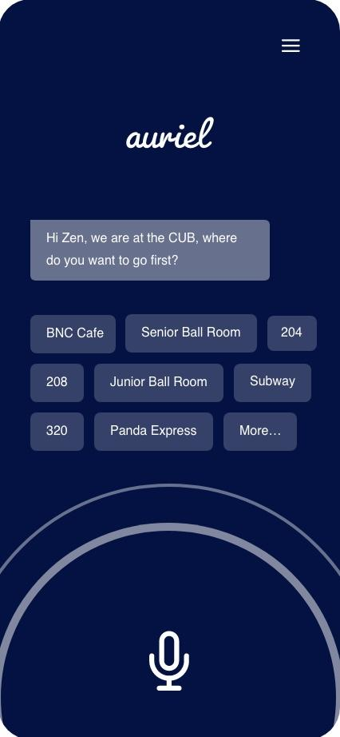
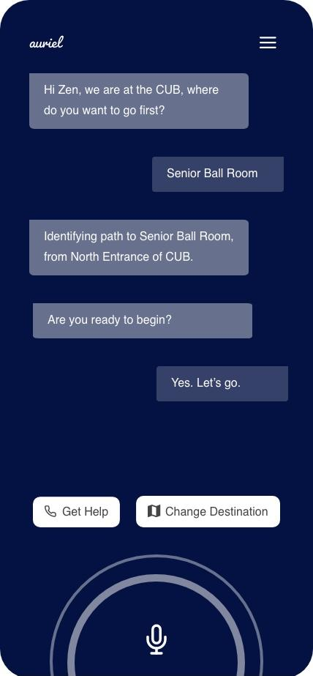
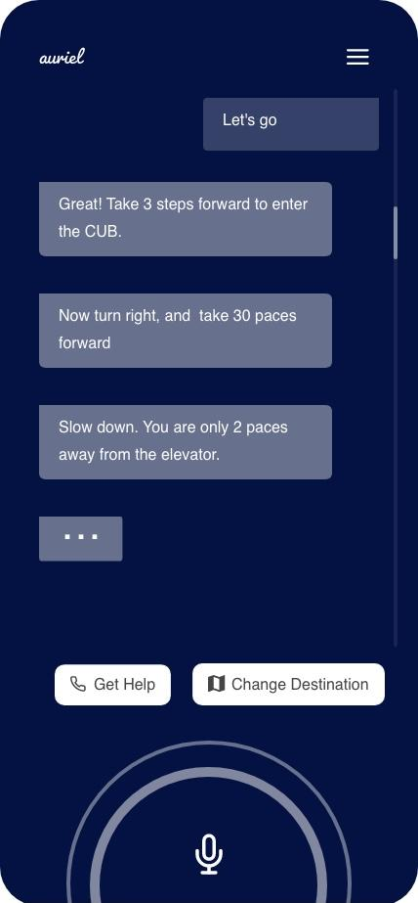
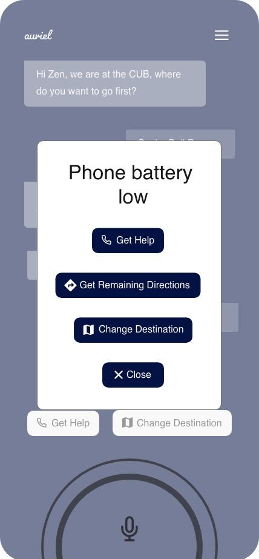

Slide 13
Why Auriel is the best tool for navigation of a blind person
With the Auriel navigation app, you will be assured that you have installed the best navigation tool available. Your experience navigating in your building will be fast, safe and intelligent. The app will connect to available cutting edge beacons to get you to your destination efficiently. We have built a fast obstacle alert system - oas to help you safely avoid unexpected objects. We use the latest technology of smartphone sensors which include motion, position, proximity, and GPS to name a few and will connect to more in the future. We feature a well designed layout to make it intuitive even for the first-time user. If you ever have an issue with our app or want to make recommendations, you can call or text our support team.

